Slide 1


Overview of Clinical and Translational Research @ CHOP
Andrea Kelly, MD, MSCE
Associate Director Center for Human Phenomic Science
September 2018
Clinical and Translational Research 101

Slide 2
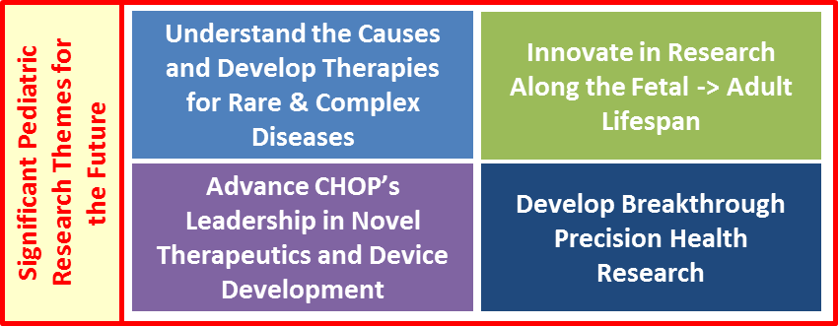
Scientific Themes to Prioritize

Slide 3
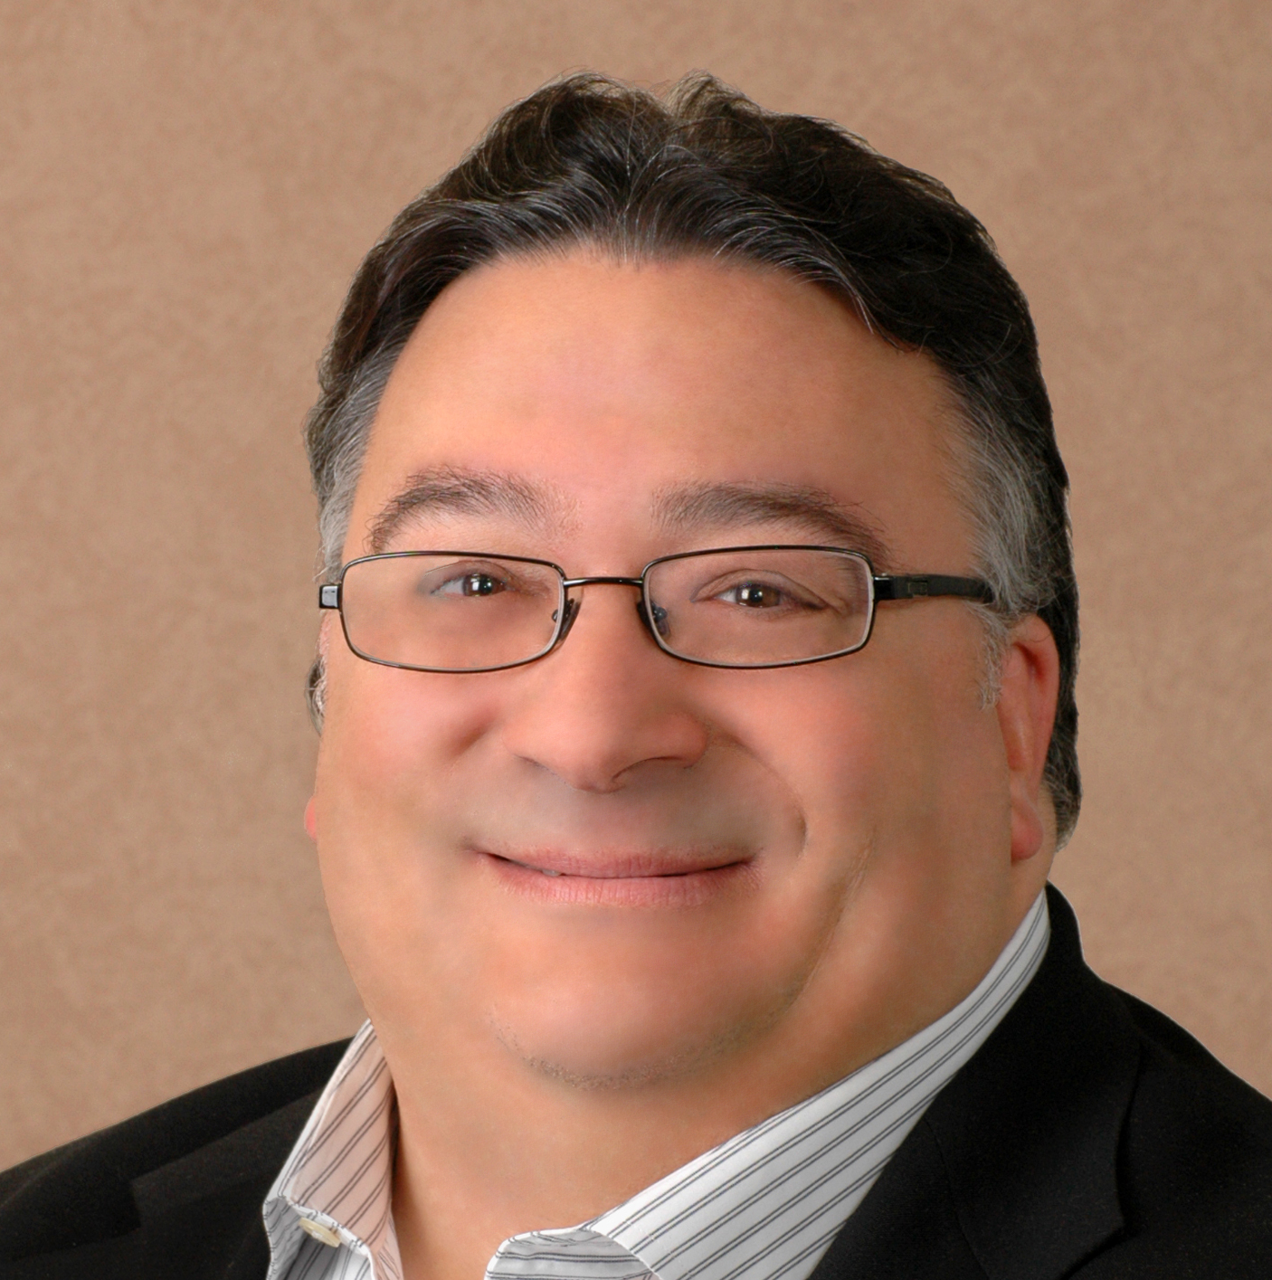
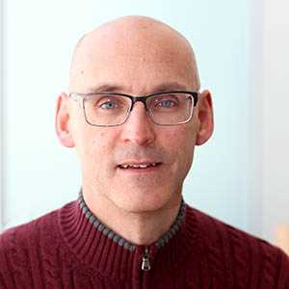
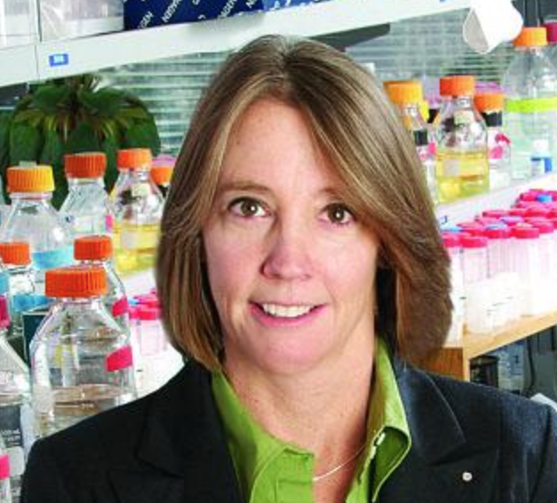
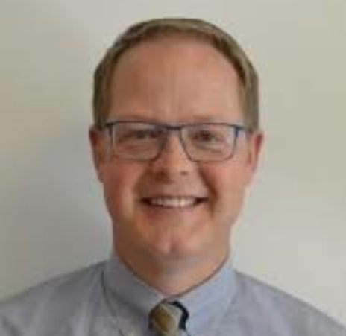
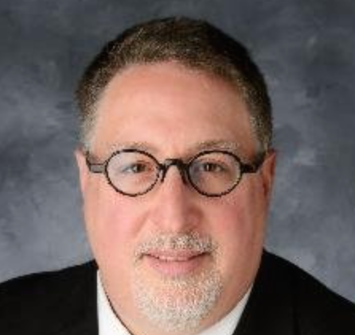
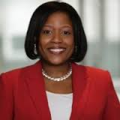
Research Institute Leadership
Bryan Wolf, MD, PhD
Chief Scientific Officer
Executive Vice President
Richard Aplenc, MD, PhD, MSCE
Chief Clinical Research Officer
Bev Davidson, PhD
Chief Scientific Strategy Officer
Fundamental Sciences
Matthew Hodgson
Assistant Vice President
Research Compliance
Zev Sunleaf
Vice President
Office of Tech Transfer
Michelle Lewis
Vice President of Research Operations

Slide 4
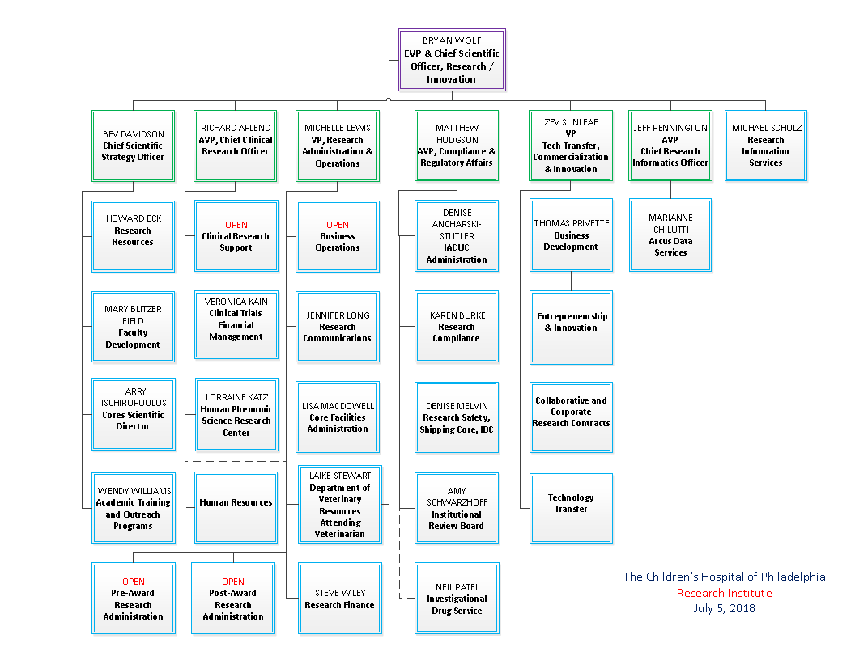

Slide 5
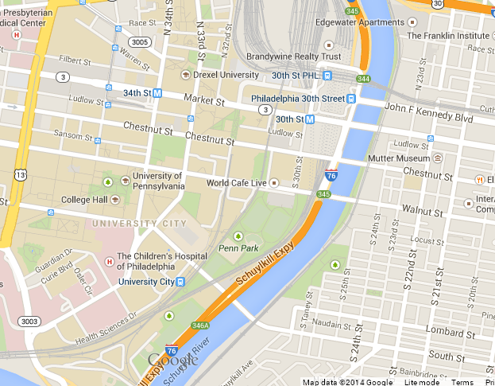
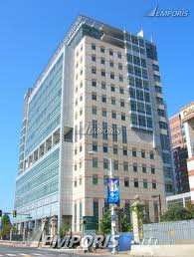
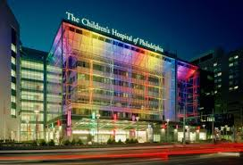
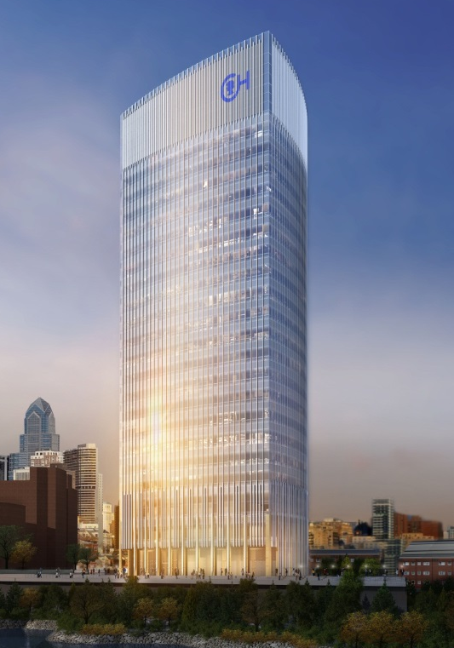
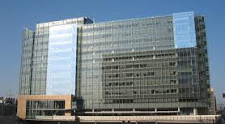
CHOP Research Institute Campus
Notes:
Clinical research- most housed at 3535 Market street
Basic research- Housed at the Leonard and Madlyn Abramson Pediatric Research Center (many core facilities are also located here), first opened in 1995, and in the Colket Translational Research Building (office and research space), which was opened in 2009
Schulykilll Avenue Building- coming in 2017- clinical research to relocate here

Slide 6
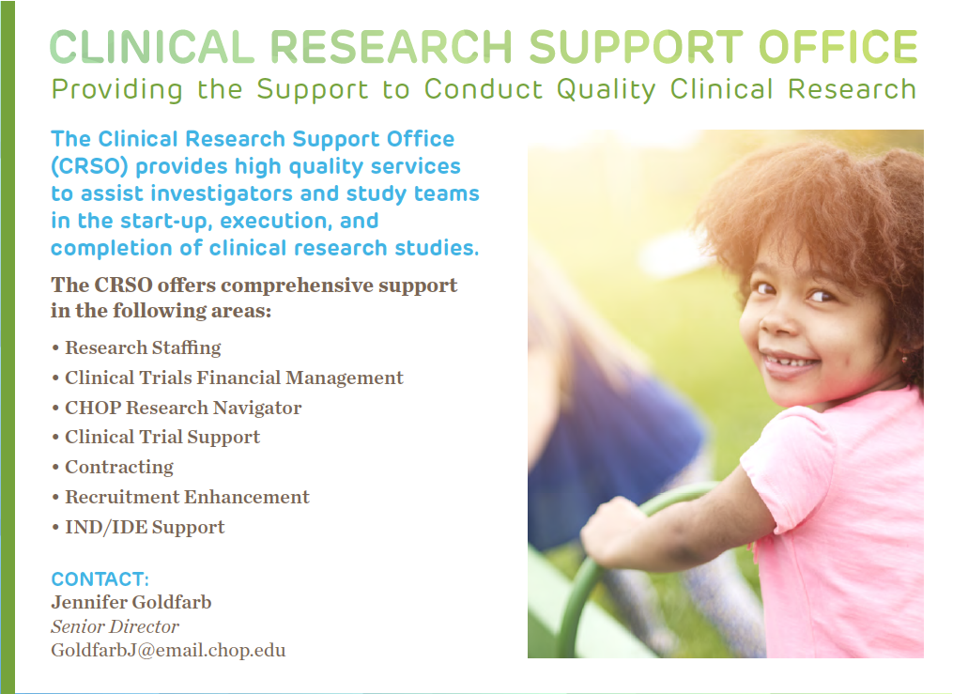
Research Staffing
Prosper—educational programs & training
Clinical Trial Support
Contracting
Recruitment enhancement
IND/IDE support
Contact: Michele Toms
P

Slide 8
CHOP Center for Human Phenomic Science (CHPS)
Funded by the NIH National Center for Advancing Translational Sciences (NCATS)
Supported by the CHOP Research Institute
Continuously funded as GCRC then CTSA since early 1960s
Mission: to provide the resources, environment, operations, and training to support and promote high-quality clinical and translational research by qualified investigators.

Slide 9
CHOP CHPS Cores
Nursing (Audrey Kamrin)
Wood Building 4 & 3550 Market St. satellite
Sleep
1 Main
Outpatient, Inpatient, scatterbed
Sample Collection, processing, shipping
Vitals
Polysomnogram
Ophthalmology
Behavioral Neuroscience (Jerilynn Radcliff)
Nutrition (Babette Zemel)
7 Main & 3550 Market St. satellite
Informatics Core (Emma Escobar)
Anthropometrics
DXA
Peripheral quantitative CT
Muscle strength
Database Development (e.g., REDCap)
Case Report Forms
Biostatistics Core (Justine Shults)
Cardiovascular (Meryl Cohen)
3 Main
Study Design
Sample Size and Power Calculations
Statistical Analysis
ECG
Echocardiogram
Pulse wave velocity
24-hr ambulatory blood pressure
Endopat
Translational Core Lab
(Research Institute, Sean Ren)
Penn CHPS
Lorraine Katz, MD—Director
John Krall Sharon Carbonara
Call Ext. 5-1383 or 5-1790
Website: https://eresearch.chop.edu/chps.php
Junior Investigator Pilot Program
Career Development Awards

Slide 11
Biostatistics and Data Management Core
Biostatistics Services
Data Management Services
Study Design
Sample Size and Power Calculations
Randomization
Statistical Analysis
Data and Safety Monitoring Boards
Grant Applications and IRB Submissions
Abstracts and Manuscripts
Methodological Research
Statistical Consulting
Database Development and Maintenance (e.g., REDCap)
Web-based Systems
Case Report Forms
Data Entry and Imaging
Audits
Creation of Analytic Datasets
Regulatory Requirements (e.g., FDA, Part 11)
The BDMC is located on the CHOP campus at:
Roberts Building, 9th Floor
267-426-7201
http://www.research.chop.edu/cores/bdmc

Slide 12
Additional Data Analytics Resources
Faculty Biostatistics Group
  Abbas Jawad, PhD
  Justine Shults, PhD- shults@email.chop.edu
  Rui Xiao, PhD
Healthcare Analytics Unit
  Heather Griffis, PhD- griffish@email.chop.edu

Slide 13
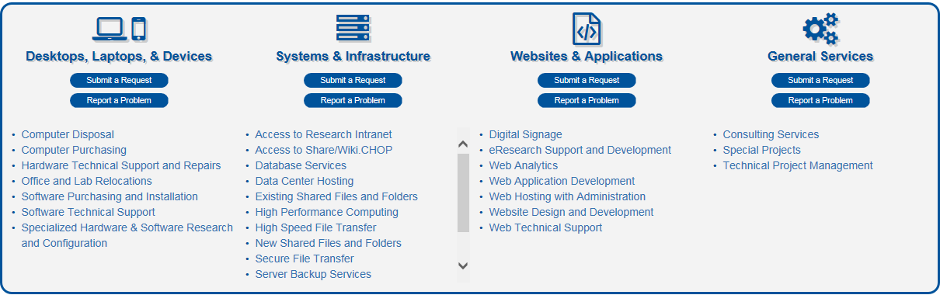
Research information services (RIS)
Web page for requests

Slide 14
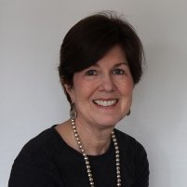
CHOP Office of Faculty Development
One-on-one meetings to welcome new CHOP faculty
  Provide names and describe roles of people who can help with academic career aside from your assigned Mentor and your Chair/Chief
  Outline departmental specific Faculty Development programs
  Website management
    Samples of successful CHOP grants (K-, R-, P- and U-type funding) and templated language for Resources
    Guidance on setting up a lab or clinical research group
    Internal (CHOP/Penn) and external (AAMC, Harvard) professional development sessions
  Faculty development sessions with internal and external speakers
Mary Blitzer Field
Assistant Director

Slide 16
Grant Review Groups
Pediatrics K and R Advisory Committees
  Review of basic and clinical proposals for K and R applications to NIH
Neuroscience Grants Club
  Reviews Rs, Ks, Fs, and private foundation grants; clinical and basic research in neuroscience
  Attendees include senior faculty, junior faculty, fellows, and post-doctoral fellows
Cell Pathology Grants Club
  Reviews basic research grants at concept stage
  Attendees include senior and junior faculty from Pathology
Grant Proposal Success Groups (Self- Assembled: Current Group focused on Immunology for NIH, foundation and internal grants for early stage investigators or basic science K awards)
  Learning and networking opportunity for investigators across campus
  Attendees include senior faculty

Slide 17
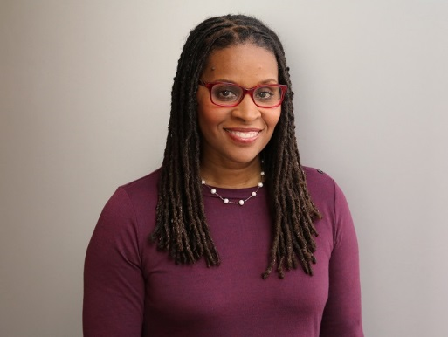
Office of Postdoctoral Affairs
Provide opportunities for research trainees to participate in career and professional development programming
Consider the Diversity Fellowship for postdocs
Support trainees in pursuing external funding
  Visit the CHOP Trainee Portal to find out more about our services and programs
Wendy Reed Williams, PhD
Director

Slide 18
Responsible Research Training
Deliver training programs and events that improve compliance with federal regulations
Use the Training Wizard to determine training requirements or contact us, researchtraining@email.chop.edu or 6-2835
Wendy Reed Williams, PhD
Director

Slide 19
Office of Postdoctoral
Affairs
Office of Responsible Research
Training
ACADEMIC PROGRAMMING
TRAINING AND ADMINISTRATION
Specialized
  Administrative
  Support for Postdocs
Stipend/Experience Review
Career/Professional
Dev’t Programs
Administration of Research Trainee
Advisory Committee
Trainee Diversity
Required Research
Training
Responsible Conduct
of Research
Instructional Design/
Module Development
Poster Day
Scientific Symposium
Other Events
Postdoc/
Physician Fellowship
Programmatic
Support
Research Training/
Event Coordination
Graduate
CRISSP
Science Leadership
Academy (SLA)
Community College of
Philadelphia (CCP)
Informal Internships
Emerging Partnerships
Science Carnival
Career Discussions
Individual
Development Plans
Diversity Outreach
and Support
  SACNAS
  ABRCMS
Outreach and Career
Development
Undergrad
Internship Program
Administration
High School

Slide 20
Scientific Communities at CHOP
Centers of Emphasis
Applied Genomics
Cellular and Molecular Therapeutics
Childhood Cancer Research
Mitochondrial and Epigenomic Medicine
Cellular and Molecular Therapeutics
Autism Research
Injury Research & Prevention
Pediatric Clinical Effectiveness
PolicyLab
Microbiome
DBHI Biomedical & Health Informatics
Notes:
Centers target efforts and resources to areas of research that will have the greatest impact on translating basic research findings into medical innovations, part of our bench-to-bedside philosophy.

Slide 21
Scientific Communities at CHOP
Research Affinity Groups (RAGs)
  Professional Society of Clinical Research
  Clinical Trials Research
  DNA-Protein Interaction
  Fetal Biology and Therapy
  Genes, Genomics and Pediatric Disease
  Global Health Research
  Health and Behavior
  METAChop (Math, Engineering and Technology)
  Metabolism, Nutrition, and Physical Development
  Mitochondria
  mHealth Research
  Neuroscience
  Normal and Malignant Hematopoiesis
  Proteins
  Protective Immunity and Immunopathology
  Qualitative Research Methods
Notes:
Research Affinity Groups increase collaboration across disciplines and link CHOP Research investigators who have common research interests.

Slide 22
